Slide 1

INFORMATION TECHNOLOGY
& IT'S APPLICATIONS

Slide 2

LAB REPORT SUMMARY
INTRODUCTION TO MS-DOS, WINDOWS, AND OFFICE TOOLS
READ MORE

Slide 3


INTRODUCTION TO MS-DOS
MS-DOS is an early operating system used for file management and resource allocation.
Features:
Single-user system
File and memory management
Command processing facilities

Slide 4



COMMON DOS
COMMANDS
Commonly Used Commands:
systeminfo: Display system information
dir: List files and folders
mkdir: Create a folder
copy: Copy files
del: Delete files

Slide 5


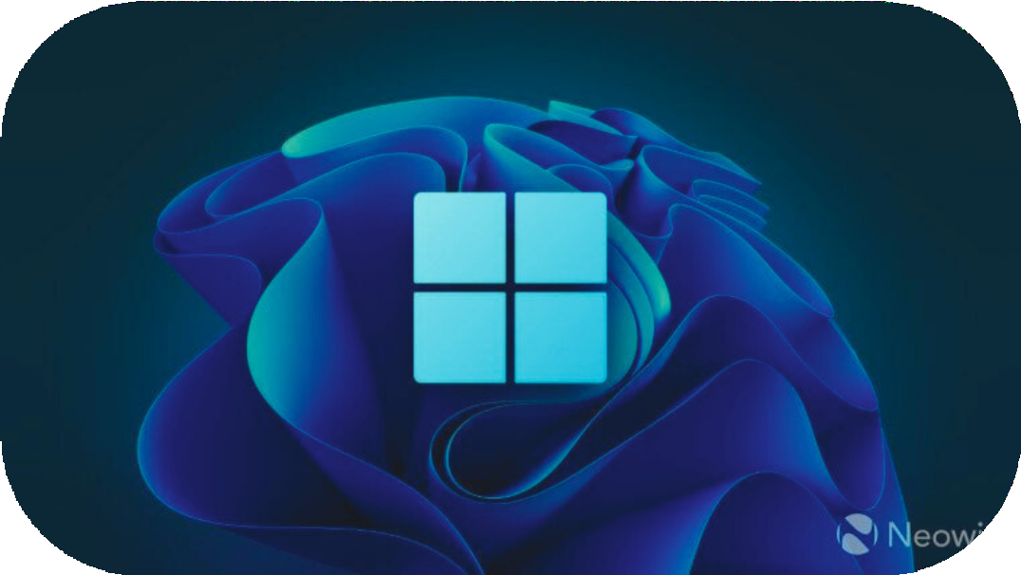



WINDOWS
OPERATING SYSTEM
Windows is a GUI based extension of DOS.
Key Elements
Start button
Taskbar & Windows explorer
Hardware&Software Compatibility

Slide 6





INTRODUCTION TO WORD PROCESSORS
A word processor is software for creating & formatting documents.
Features include
Text formatting
Insert multimedia and tables Spelling and grammar checks

Slide 7


LAB
DESIGN IDENTITY CARD
Steps to create an identity card in Word:
Use Insert > Shapes to create a rectangle.
Add text using WordArt.
Customize colors and alignment.

Slide 8


MAIL MERGE IN MS WORD
Mail merge allows combining data into letters or labels.
Steps:
Select Mailings > Start Mail Merge.
Connect a recipient list.
Insert fields and preview.

Slide 9




